Slide 1
Spring boot & JSON Web Token
Spring boot application using JWT as a form of security

Slide 2
JSON web token(JWT)
What is JWT?
When Should we use JWT?
Structure of JWT
Spring boot setup
Dependencies for JWT
Resources and links

Slide 3
What is JWT?
it is an open standard (RFC 7519) that defines a compact and self-contained way for securely transmitting information between parties as a JSON object.
It can be verified and trusted because it is digitally signed using HMAC or public/private key pair using RSA or ECDSA

Slide 4
When Should we use JWT?
Authorization: The most common scenario for using JWT. Once the user is logged in, every request made by the user have to include the JWT.
Information Exchange: JWT is a secure way of transmitting information between parties because it signed and trusted by both end.

Slide 5
Structure of JWT
JWT consist of three parts. The Header, Payload and signature which are separated by a dots(.)
JWT will typically looks like xxxxx.yyyyy.zzzz
The X’s being the header, the Y’s the payload and the Z’s the signature.

Slide 6
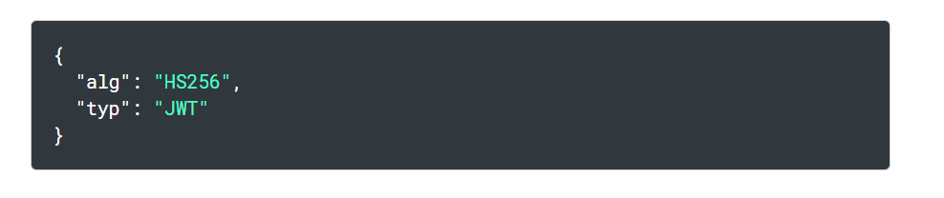
Header of a JWT
The Header have two parts. The type of the token that is JWT, and the signed algorithm being used, such as HMAC, SHA256, or RSA.

Slide 7
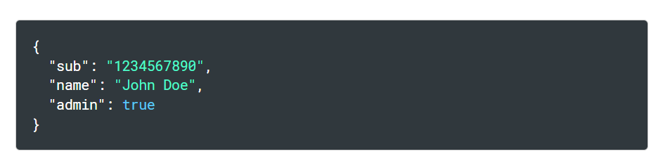
Payload
Payload contains claims which are statements about the user and additional data.

Slide 8
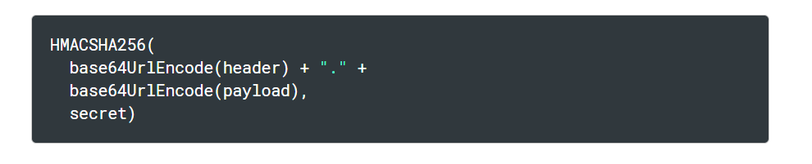
Signature
The signature is made up of the encoded header, payload, a secret and the algorithm specified in the header.
Using the above it is signed. The signature is used to verify the message wasn’t changed along the way and if there is a private key, it can verify the sender

Slide 9
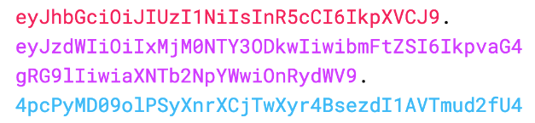
The Header, the Payload and the Signature
The end of the putting all the three part together is a three Base-64 URL strings separated by a dots.

Slide 10
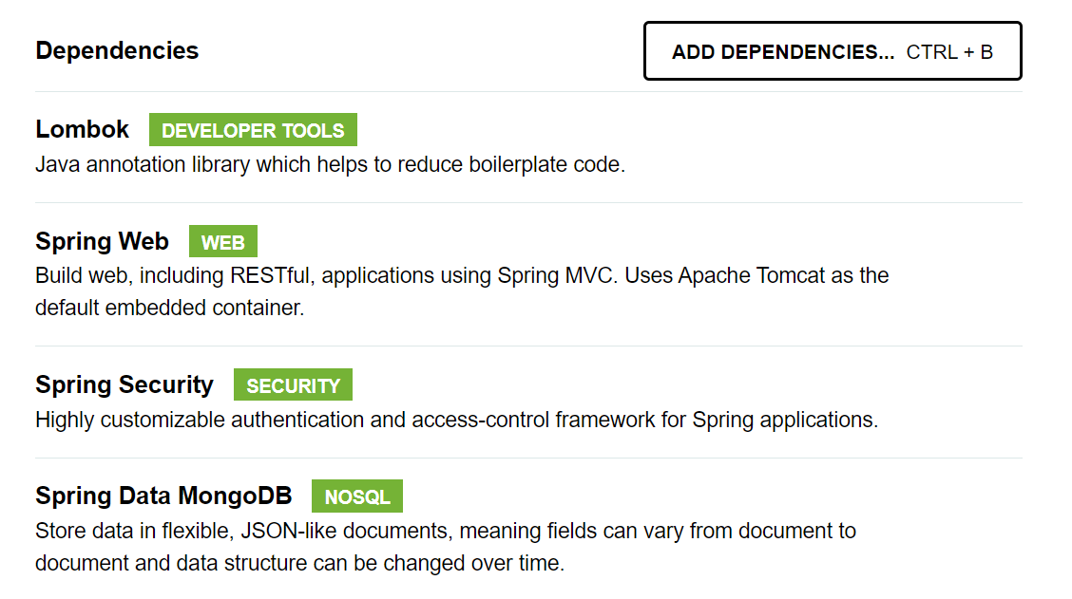
Spring boot setup

Slide 11
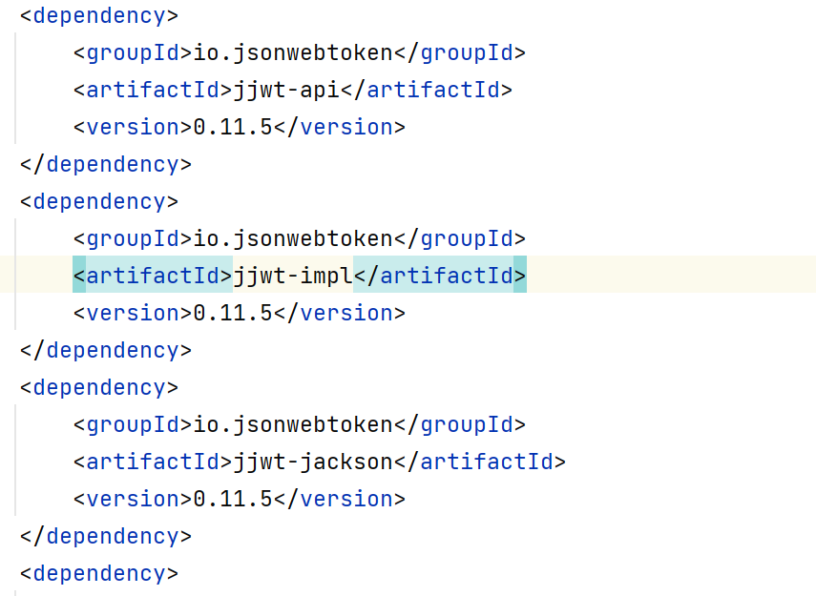
JWT dependencies

Slide 12
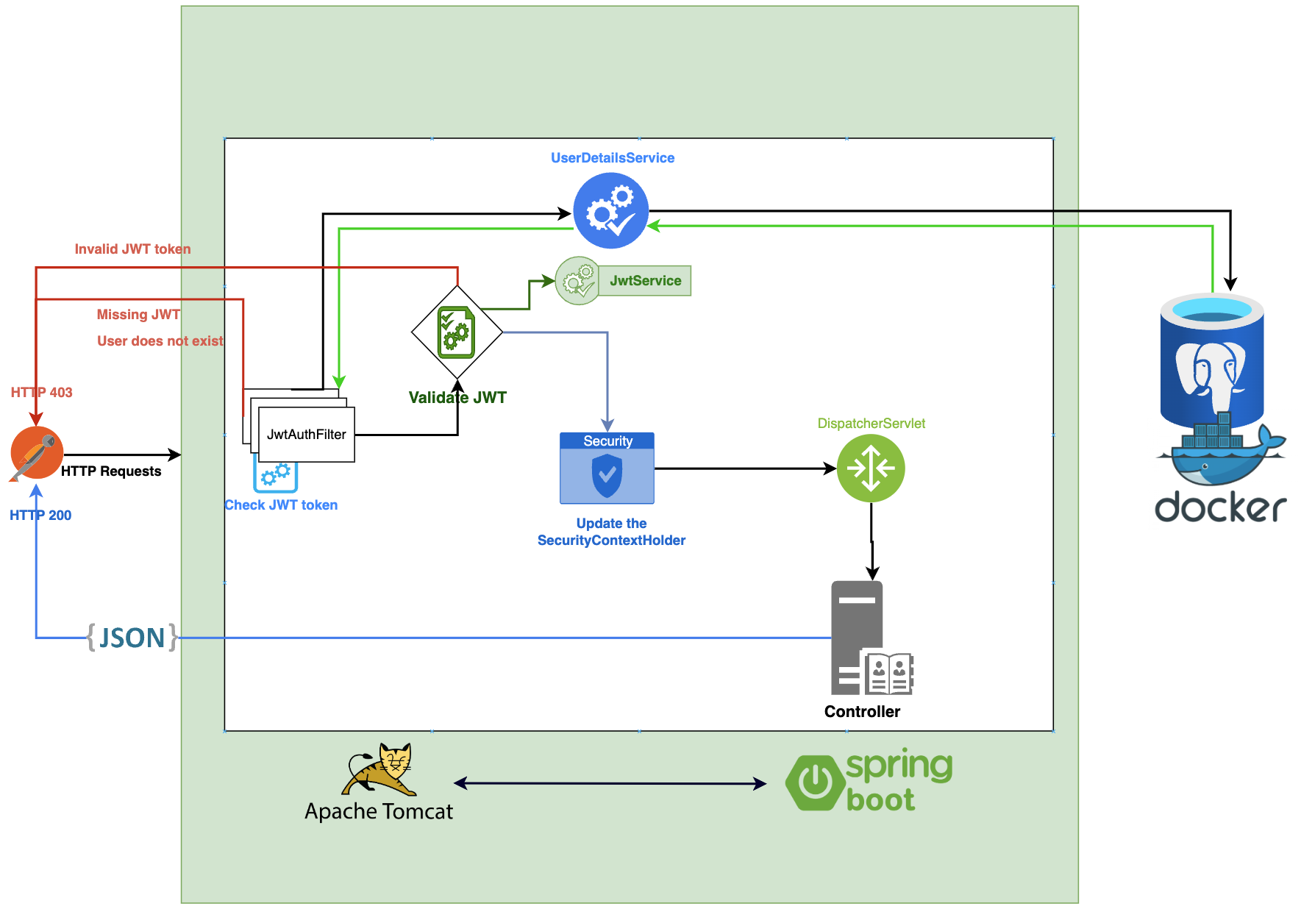
Data movement steps

Slide 13
Resources and links.
https://www.youtube.com/watch?v=KxqlJblhzfI
https://jwt.io/introduction
https://mvnrepository.com/artifact/io.jsonwebtoken
https://www.allkeysgenerator.com/Random/Security-Encryption-Key-Generator.aspx

